Slide 1
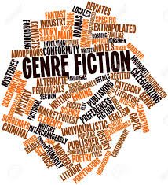
Genre Conventions
Y12 General English

Slide 2
Crime Fiction
The detective solves the crime so evil is caught. No matter what style of detective they are moral and righteous.
The sleuth of crime fiction is good and that those he/she exposes are evil.
The social threat is removed by the resolution of a crime fiction. The fractured lives of the characters have logic and order restored.

Slide 3
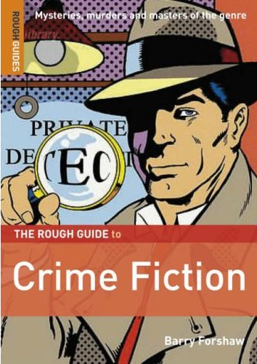
Crime Fiction
Whilst the mystery has been cleared up there is a sense that it is only a brief respite.
Techniques used
Suspense.
Cliffhangers.
Foreshadowing

Slide 4
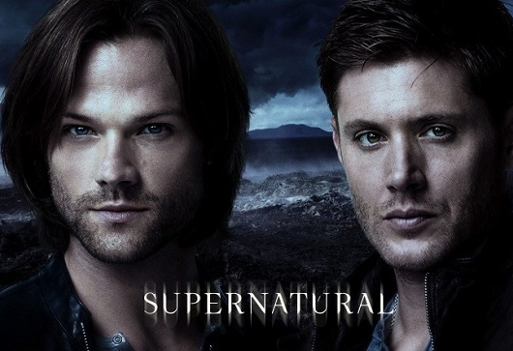
Supernatural Fiction
Genre that centres around supernatural elements, such as ghosts, gods, goddesses, and miracles.
Supernatural fiction deal with the unknown questions of life; therefore, they tend to incorporate religious elements into the plot
Happy endings possible, but would be kind of a letdown after all that terror.

Slide 5

Sport Fiction
The sports film is a particular sort of adventure film.
Sport is a method for character change.
A central character is a gifted athlete who tests himself within the sport.
Characters struggle with issues related to sports.
Team sports are usually emphasized.
Plot and characterization often emphasize theses such as team play and sportsmanship

Slide 6

Horror
Seeks to elicit responses of fear, terror, disgust, shock, suspense, and, of course, horror from their viewers.
Techniques
Fear. At the risk of pointing out the elephant in the room, fear is by far the most important factor of a great horror story. ...
Surprise. Getting someone to fear what you've created isn't the hardest part; making the fear surprising is. ...
Suspense. ...
Mystery. ...
Spoilers.
Happy endings possible, but would be kind of a letdown after all that terror.

Slide 7
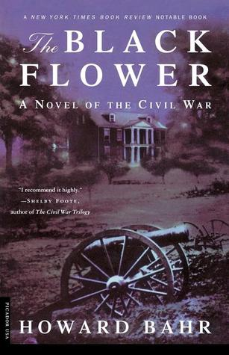
War Fiction
War fiction is that where the primary action takes place
in a field of armed combat,
in a domestic setting (or home front) where the characters are preoccupied with the preparations for, or recovery from, war.
Much war fiction is set in a period in the past, also allowing them to fit in the genre of historical fiction.
It is equally composed of character-driven and plot-driven stories.
Happy endings allowed only if they are historically accurate.

Slide 8
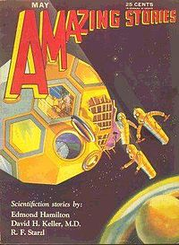
Science Fiction
Set in a future that scientific or technological advance could or might make possible.
In one approach the story usually takes place in outer space where the technology of the future is predicted.
In the other approach future societies are portrayed, usually on earth, with or without the presence of aliens.
Themes frequently deal with good or evil, often involving technology.
Happy endings are ok, unless your characters have moved beyond earth-bound notions of “happiness” or “endings.”

Slide 9
SciFi Techniques
Setting in an Alternative World
Non-human Characters
Science and Technology
Time Travel
Journey
Dystopia
Age of Reason
Advances in Science and Technology

